Slide 1
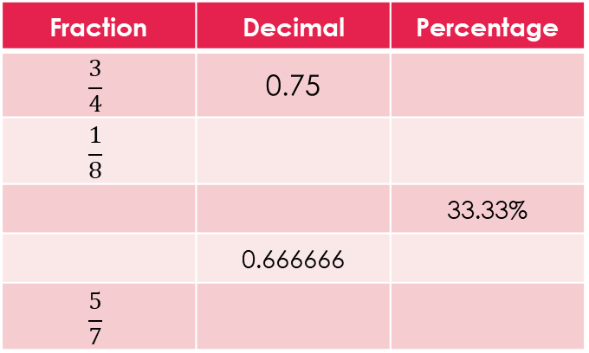
Topic: Two way tables EQ: How do we represent outcomes in two way tables for experimental and theoretical probability?
Review questions (on LHS)
Complete the table
Steps to be successful this lesson:
Get materials out (notebook, pen, pencil, ruler, calculator)
Rule up notebook and write Topic and EQ
Start on review questions →
Check your answers with someone sitting next to you
Is your notebook up to date? (Contents page, glossary, review notes etc.)
Fraction | Decimal | Percentage
$$\frac{3}{4}$$ | 0.75
$$\frac{1}{8}$$
 |  | 33.33%
 | 0.666666
$$\frac{5}{7}$$

Slide 2
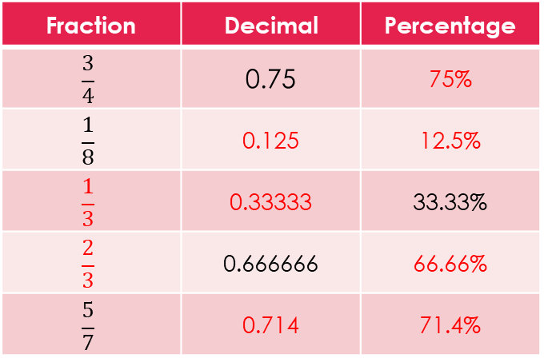
Topic: Two way tables EQ: How do we represent outcomes in two way tables for experimental and theoretical probability?
Review questions (on LHS)
Complete the table
Steps to be successful this lesson:
Get materials out (notebook, pen, pencil, ruler, calculator) and put bags in pigeon holes.
Rule up notebook and write Topic and EQ
Start on review questions →
Check your answers with someone sitting next to you
Is your notebook up to date? (Contents page, glossary, review notes etc.)
Fraction | Decimal | Percentage
$$\frac{3}{4}$$ | 0.75 | 75%
$$\frac{1}{8}$$ | 0.125 | 12.5%
$$\frac{1}{3}$$ | 0.33333 | 33.33%
$$\frac{2}{3}$$ | 0.666666 | 66.66%
$$\frac{5}{7}$$ | 0.714 | 71.4%

Slide 3
Yr 10. Two way tables
EQ:How do we represent outcomes in two way tables for experimental and theoretical probability?

Slide 4

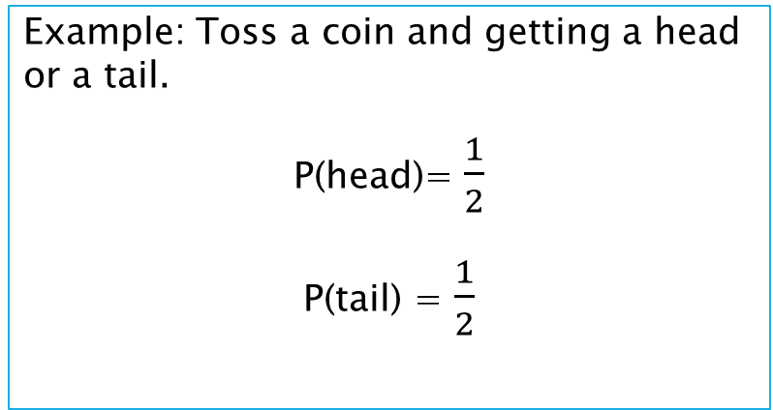
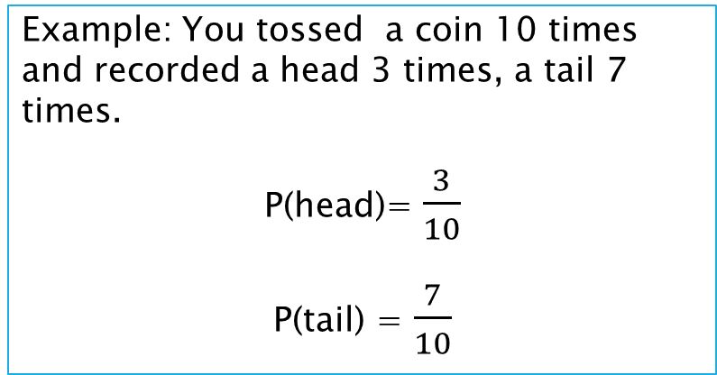
24
7
30
Topic: Two way tables
Date:
EQ – How do we represent outcomes in two way tables for experimental and theoretical probability?
Experimen vs. Theory
Probabilty can have two approaches:
Experimental Probability and Theoretical Probability
What actually happens vs. What we think will happen
P (event) = $\frac{number of times event occurs}{total number of trials}$ P (event) = $\frac{number of favorable outcomes}{number of possible outcomes}$
Example: You tossed a coin 10 times and recorded a head 3 times, a tail 7 times.
P(head)= $\frac{3}{10}$
P(tail) = $\frac{7}{10}$
Example: Toss a coin and getting a head or a tail.
P(head)= $\frac{1}{2}$
P(tail) = $\frac{1}{2}$

Slide 5
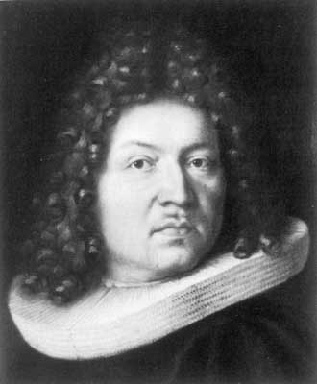

24
7
30
Topic: Two way tables
Date:
EQ – How do we represent outcomes in two way tables for experimental and theoretical probability?
Experiment vs. Theory
Probabilty can have two approaches:
Experimental Probability and Theoretical Probability
What actually happens vs. What we think will happen
P (event) = $\frac{number of times event occurs}{total number of trials}$ P (event) = $\frac{number of favorable outcomes}{number of possible outcomes}$
The Law of Large numbers
The Law of Large Numbers was first published in 1713 by Jocob Bernoulli.
It is a fundamental concept for probability and statistic.
This Law states that as the number of trials increase, the experimental probability will get closer and closer to the theoretical probability.

Slide 6
24
7
30
Topic: Two way tables
Date:
EQ – How do we represent outcomes in two way tables for experimental and theoretical probability?
Two Way Tables
A two – way table is one way to display the outcome of a 2 step experiment, we use the results to calculate probability.
Example
a dice is thrown and a coin is tossed. Determine the possible outcomes
1. List all possible outcomes in a table.
 | 1 | 2 | 3 | 4 | 5 | 6
Heads
Tails

Slide 7
24
7
30
Topic: Two way tables
Date:
EQ – How do we represent outcomes in two way tables for experimental and theoretical probability?
Two Way Tables
A two – way table is one way to display the outcome of a 2 step experiment, we use the results to calculate probability.
Example
a dice is thrown and a coin is tossed. Determine the possible outcomes
2. Fill in the table with all options.
 | 1 | 2 | 3 | 4 | 5 | 6
Heads | 1, Heads | 2, Heads | 3, Heads | 4, Heads | 5, Heads | 6, Heads
Tails | 1, Tails | 2, Tails | 3, Tails | 4, Tails | 5, Tails | 6, Tails

Slide 8
24
7
30
Topic: Two way tables
Date:
EQ – How do we represent outcomes in two way tables for experimental and theoretical probability?
Two Way Tables
A two – way table is one way to display the outcome of a 2 step experiment, we use the results to calculate probability.
Example
a dice is thrown and a coin is tossed. Determine the possible outcomes
Using your table, determine the probability of;
1. getting a 4 and a tails? - This is written as P{4 and T}
 | 1 | 2 | 3 | 4 | 5 | 6
Heads | 1, Heads | 2, Heads | 3, Heads | 4, Heads | 5, Heads | 6, Heads
Tails | 1, Tails | 2, Tails | 3, Tails | 4, Tails | 5, Tails | 6, Tails

Slide 9

24
7
30
Topic: Two way tables
Date:
EQ – How do we represent outcomes in two way tables for experimental and theoretical probability?
Two Way Tables
A two – way table is one way to display the outcome of a 2 step experiment, we use the results to calculate probability.
Example
a dice is thrown and a coin is tossed. Determine the possible outcomes
What is the probability of;
1. getting a 4 and a tails? P{4 and T}= $\frac{1}{12}$ - this is also 0.0833, or 8.33%.
 | 1 | 2 | 3 | 4 | 5 | 6
Heads | 1, Heads | 2, Heads | 3, Heads | 4, Heads | 5, Heads | 6, Heads
Tails | 1, Tails | 2, Tails | 3, Tails | 4, Tails | 5, Tails | 6, Tails

Slide 10

24
7
30
Topic: Two way tables
Date:
EQ – How do we represent outcomes in two way tables for experimental and theoretical probability?
Two Way Tables
A two – way table is one way to display the outcome of a 2 step experiment, we use the results to calculate probability.
Example
a dice is thrown and a coin is tossed. Determine the possible outcomes
What is the probability of;
1. 4 and a tails? P(4 and T) = $\frac{1}{12}$
2. <5 and heads? P(<5 and H) =
 | 1 | 2 | 3 | 4 | 5 | 6
Heads | 1, Heads | 2, Heads | 3, Heads | 4, Heads | 5, Heads | 6, Heads
Tails | 1, Tails | 2, Tails | 3, Tails | 4, Tails | 5, Tails | 6, Tails

Slide 11

24
7
30
Topic: Two way tables
Date:
EQ – How do we represent outcomes in two way tables for experimental and theoretical probability?
Two Way Tables
A two – way table is one way to display the outcome of a 2 step experiment, we use the results to calculate probability.
Example
a dice is thrown and a coin is tossed. Determine the possible outcomes
What is the probability of;
1. 4 and a tails? P(4 and T) = $\frac{1}{12}$
2. <5 and heads? P(<5 and H) = $\frac{4}{12}\text{= }\frac{1}{3}$
 | 1 | 2 | 3 | 4 | 5 | 6
Heads | 1, Heads | 2, Heads | 3, Heads | 4, Heads | 5, Heads | 6, Heads
Tails | 1, Tails | 2, Tails | 3, Tails | 4, Tails | 5, Tails | 6, Tails

Slide 12

24
7
30
Topic: Two way tables
Date:
EQ – How do we represent outcomes in two way tables for experimental and theoretical probability?
Two Way Tables
A two – way table is one way to display the outcome of a 2 step experiment, we use the results to calculate probability.
Example
a dice is thrown and a coin is tossed. Determine the possible outcomes
What is the probability of;
1. 4 and a tails? - P{4 and } = $\frac{1}{12}$
2. <5 and heads? - P{<5 and H} = $\frac{4}{12}\text{= }\frac{1}{3}$
3. Anything but 3? - P{3’}
 | 1 | 2 | 3 | 4 | 5 | 6
Heads | 1, Heads | 2, Heads | 3, Heads | 4, Heads | 5, Heads | 6, Heads
Tails | 1, Tails | 2, Tails | 3, Tails | 4, Tails | 5, Tails | 6, Tails

Slide 13

24
7
30
Topic: Two way tables
Date:
EQ – How do we represent outcomes in two way tables for experimental and theoretical probability?
Two Way Tables
A two – way table is one way to display the outcome of a 2 step experiment, we use the results to calculate probability.
Example
a dice is thrown and a coin is tossed. Determine the possible outcomes
What is the probability of;
1. 4 and a tails? - P{4 and } = $\frac{1}{12}$
2. <5 and heads? - P{<5 and H} = $\frac{4}{12}\text{= }\frac{1}{3}$
3. Anything but 3? - P{3’} = $\frac{10}{12}$ = $\frac{5}{6}$
 | 1 | 2 | 3 | 4 | 5 | 6
Heads | 1, Heads | 2, Heads | 3, Heads | 4, Heads | 5, Heads | 6, Heads
Tails | 1, Tails | 2, Tails | 3, Tails | 4, Tails | 5, Tails | 6, Tails

Slide 14


Slide 15
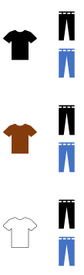
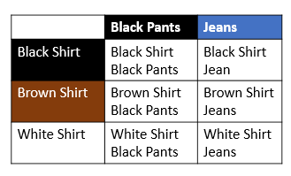
Worked example.
Jeff owns a brown shirt, a white shirt and a black shirt. He also owns a pair of black pants and a pair of blue jeans. How many combinations can he make from these items.
What is the probability that;
Today Jeff is wearing a white shirt and blue jeans?
Sample Space n=6.
{ BaBa, BaBl, BrBa, BrBl, Wba, WBl}
What is the Probability that today Jeff is wearing black pants and a blue or brown shirt?
Ba = Black, Bl = Blue, W= White

Slide 16
24
7
30
Topic: Two way tables
Date:
EQ – How do we represent outcomes in two way tables for experimental and theoretical probability?
Two Way Tables
Two way tables can also be useful for experiments that have two variables that you are looking at.
E.g. Comparing pet preferences between dogs and cats
 | Dogs | Dislikes dogs | Total
Cats | 29 | 1 | 30
Dislikes cats | 8 | 12 | 20
Total | 37 | 13 | 50

Slide 17
24
7
30
Topic: Two way tables
Date:
EQ – How do we represent outcomes in two way tables for experimental and theoretical probability?
Two Way Tables
Two way tables can also be useful for experiments that have two variables that you are looking at.
E.g. Comparing fruit preferences between apples and bananas
 | Dogs | Dislikes dogs | Total
Cats | 29 | 1 | 30
Dislikes cats | 8 | 12 | 20
Total | 37 | 13 | 50
What is the probability of a person liking cats?
What is the probability of a person liking cats and dogs?

Slide 18
24
7
30
Topic: Two way tables
Date:
EQ – How do we represent outcomes in two way tables for experimental and theoretical probability?
Two Way Tables
Two way tables can also be useful for experiments that have two variables that you are looking at.
E.g. Comparing fruit preferences between apples and bananas
 | Dogs | Dislikes dogs | Total
Cats | 29 | 1 | 30
Dislikes cats | 8 | 12 | 20
Total | 37 | 13 | 50
What is the probability of a person liking catss?
P (cats) = event/total number of outcomes
P (cats) = 30/50 = 3/5

Slide 19
24
7
30
Topic: Two way tables
Date:
EQ – How do we represent outcomes in two way tables for experimental and theoretical probability?
Two Way Tables
Two way tables can also be useful for experiments that have two variables that you are looking at.
E.g. Comparing fruit preferences between apples and bananas
 | Dogs | Dislikes dogs | Total
Cats | 29 | 1 | 30
Dislikes cats | 8 | 12 | 20
Total | 37 | 13 | 50
What is the probability of a person liking dogs?
P (dogs) = event/total number of outcomes
P (dogs) = 37/50

Slide 20
24
7
30
Topic: Two way tables
Date:
EQ – How do we represent outcomes in two way tables for experimental and theoretical probability?
Two Way Tables
Two way tables can also be useful for experiments that have two variables that you are looking at.
E.g. Comparing fruit preferences between apples and bananas
 | Dogs | Dislikes dogs | Total
Cats | 29 | 1 | 30
Dislikes cats | 8 | 12 | 20
Total | 37 | 13 | 50
Out of the people who like catss, what is the probability of someone not liking dogs?

Slide 21
24
7
30
Topic: Two way tables
Date:
EQ – How do we represent outcomes in two way tables for experimental and theoretical probability?
Two Way Tables
Two way tables can also be useful for experiments that have two variables that you are looking at.
E.g. Comparing fruit preferences between apples and bananas
 | Dog | Dislikes dogs | Total
Cats | 29 | 1 | 30
Dislikes cats | 8 | 12 | 20
Total | 37 | 13 | 50
Out of the people who like cats, what is the probability of someone not liking dogs?
P (bananas ∩ apples’) = 1/30 Note: ∩ means “and”

Slide 23
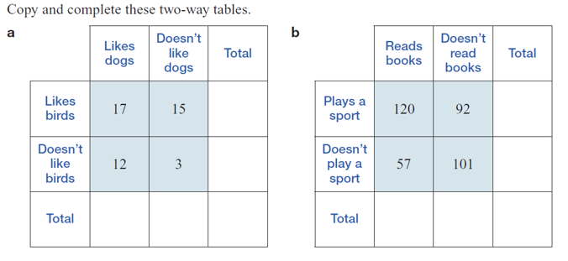
LHS practise

Slide 24
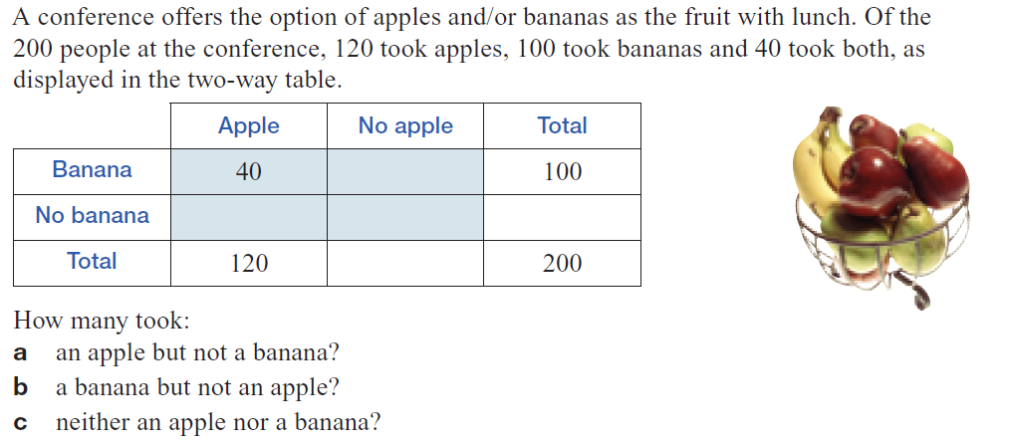
LHS practise

Slide 25
LHS practise
Complete Ex 6.5 Q9, 22 & 23 from Nelson Maths 10 on pg 247& 250
And
Complete the summary for this lesson.

